Slide 1
C5: Prompt Engineering With RAG

Slide 2
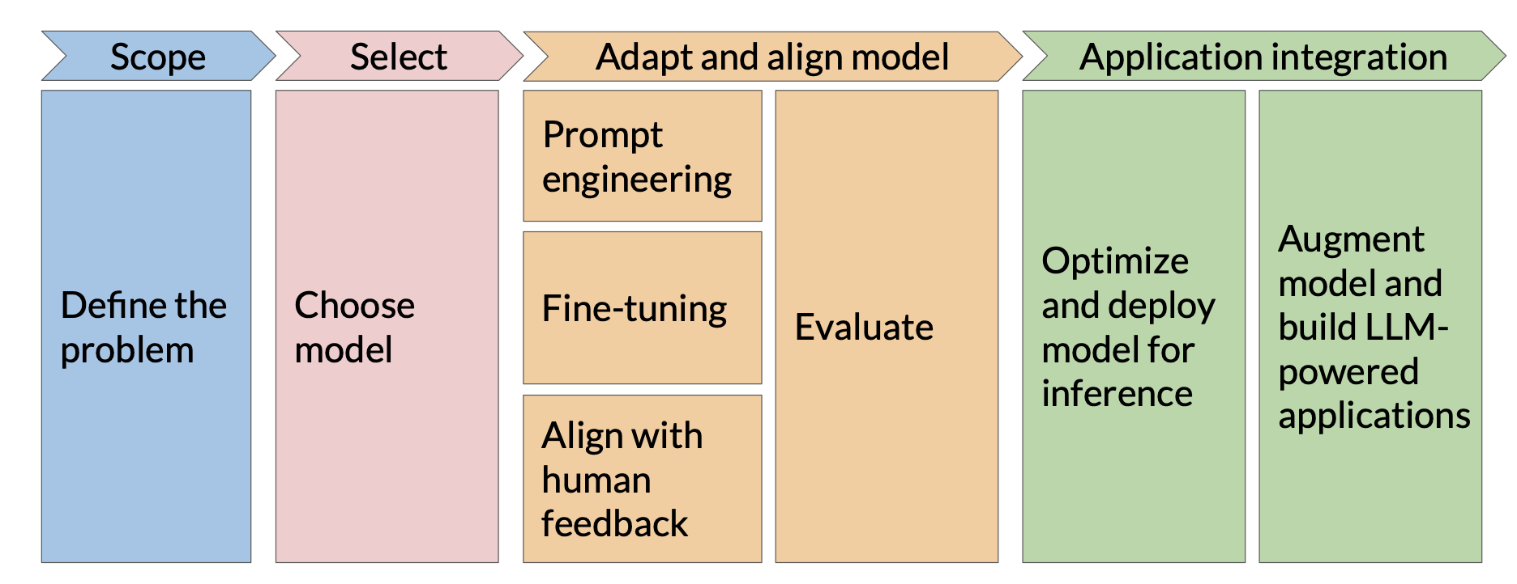
Prompt engineering

Slide 3
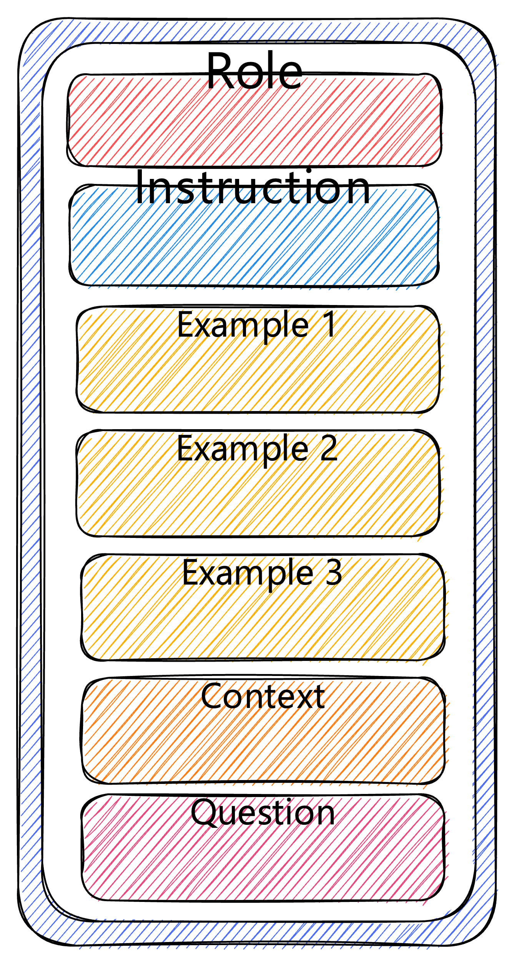
Prompt engineering
Prompts typically include role, instructions, examples, context, question.
Context & Examples – dependent on question.
How do we decide what examples to choose?
How do we decide what context to use?

Slide 4
Prompt engineering
Prompts typically include role, instructions, examples, context, question.
Context & Examples – dependent on question.
How do we decide what examples to choose?
How do we decide what context to use?

Slide 5
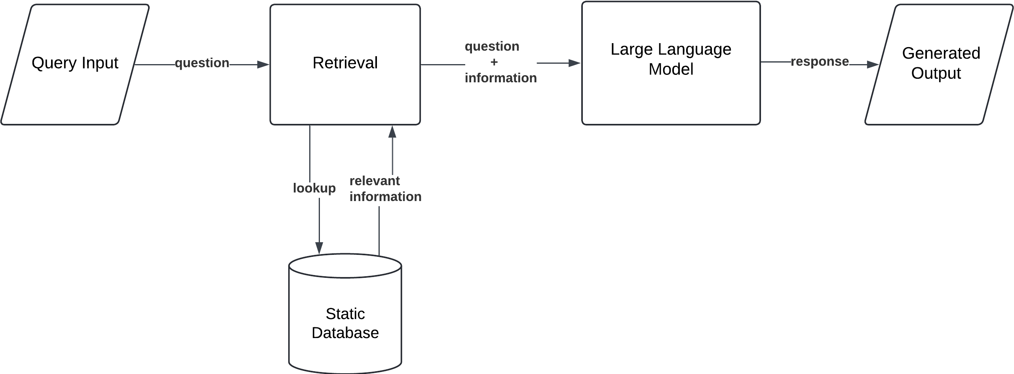
Retrieval-Augmented Generation
RAG is a hybrid approach that combines retrieval of relevant external information with generation of responses using a large language model (LLM). Designed to enhance factual accuracy, expand knowledge, and reduce hallucination by pulling in information beyond the model’s internal parameters.

Slide 6
Retrieval-Augmented Generation
RAG is a hybrid approach that combines retrieval of relevant external information with generation of responses using a large language model (LLM). Designed to enhance factual accuracy, expand knowledge, and reduce hallucination by pulling in information beyond the model’s internal parameters.

Slide 7
Retrieval-Augmented Generation
RAG is a hybrid approach that combines retrieval of relevant external information with generation of responses using a large language model (LLM). Designed to enhance factual accuracy, expand knowledge, and reduce hallucination by pulling in information beyond the model’s internal parameters.
That’s a bit more complex

Slide 8
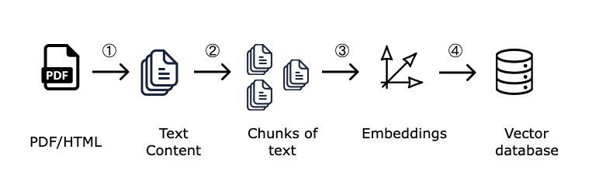
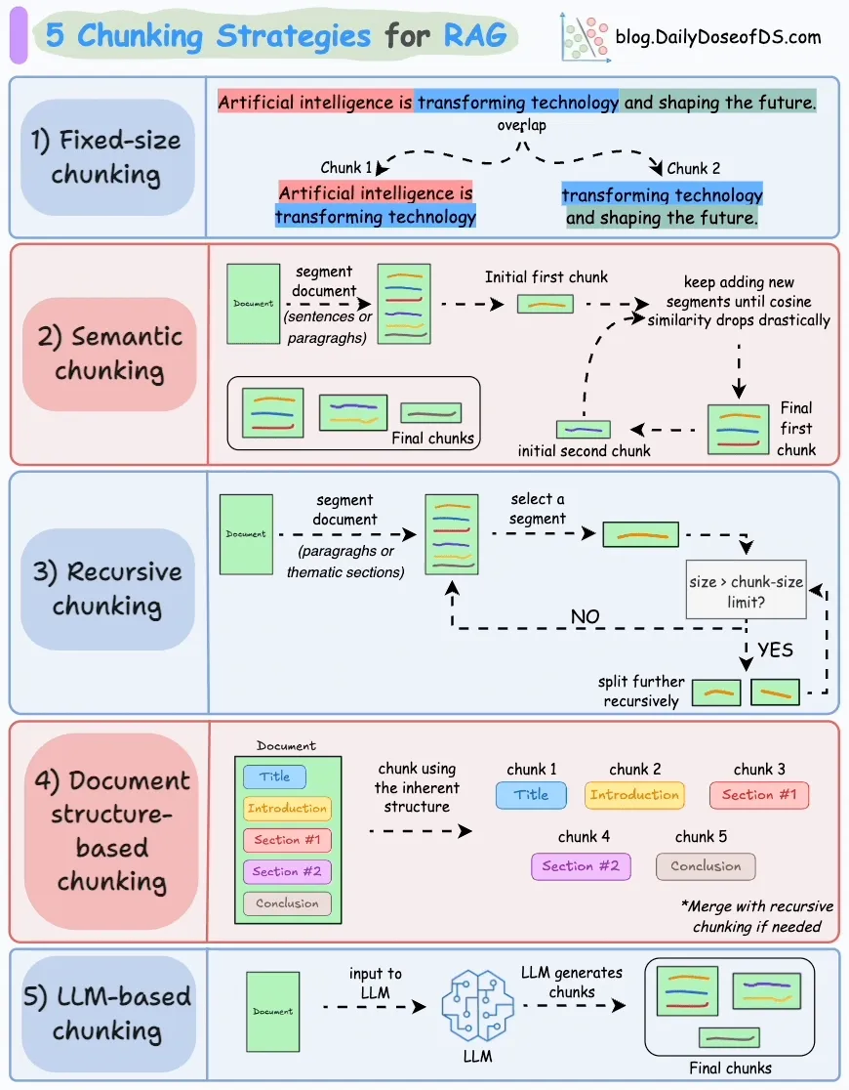
Prepare vector database
Embedding model

Slide 9
The retrieval step in RAG
Steps:
1. Embedding the user query into a vector (same embedding space as documents)
2. Running a similarity search in the vector database
3. Returning the top-k most similar chunks to use as context for generation.
Exact Nearest Neighbor Search (NN) Brute-force comparison with every vector in the database.
Very accurate, but slow and expensive for large datasets.
Approximate Nearest Neighbor (ANN) Search
Returns close-enough matches much faster. Massively scales to millions/billions of vectors.
Trade-off: some accuracy lost for speed.

Slide 10
The retrieval step in RAG
Steps:
1. Embedding the user query into a vector (same embedding space as documents)
2. Running a similarity search in the vector database
3. Returning the top-k most similar chunks to use as context for generation.
HNSW 1. Each node is a vector embedding.
2. Nodes are connected to others based on distance.
3. Hierarchy of layers: higher layers are sparser, lower layers are denser. Search steps:
• Start from a random entry point at the top layer.
• Use greedy search to find the closest node.
• Move down layers while improving the match.
• Stop when reaching the best neighbors in the bottom layer.
FAISS 1. Vector space is clustered into centroids.
2. Each new document vector is assigned to the nearest centroid.
3. For a query:
• Identify the top few centroids nearest to the query vector.
• Search only within those clusters.

Slide 11
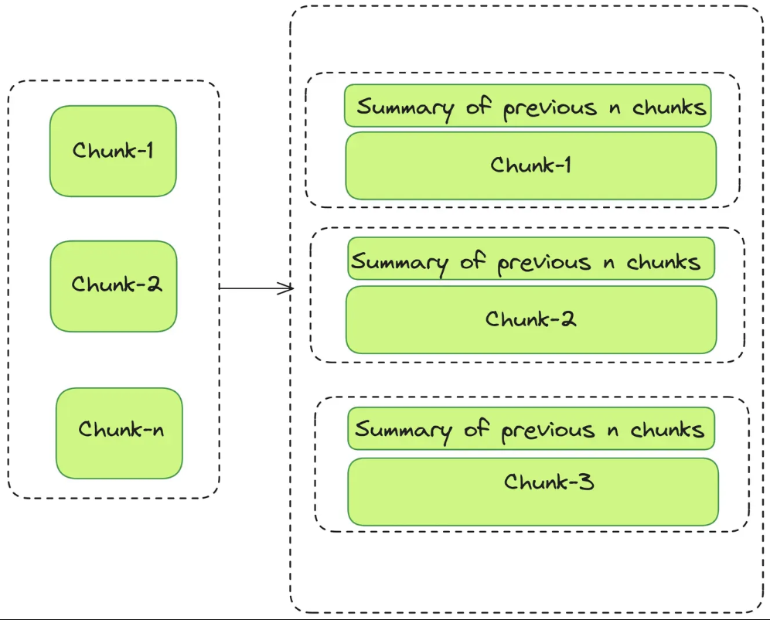
Strategy for retrieval
Tips for Choosing K:
• K too small? Risk missing relevant info.
• K too large? Context gets diluted or truncated.
Typically: K = 3–10, depending on:
• Context window size (e.g., 4k vs 16k tokens)
• Chunk size and density
One solution: summarize

Slide 12
The retrieval step in RAG
Hybrid search: semantic search (embeddings) + keywords

Slide 13
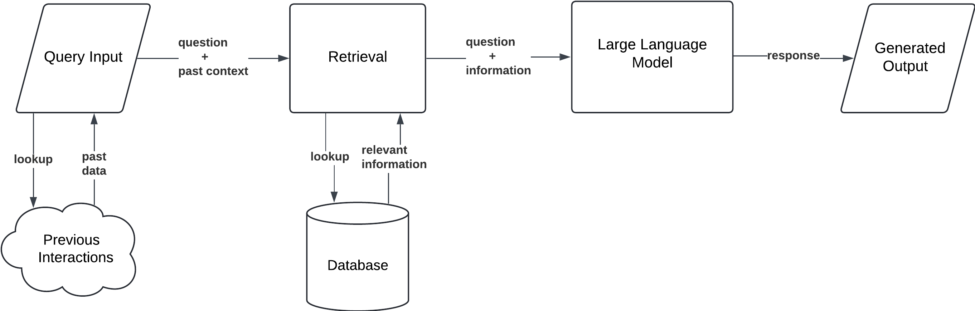
RAG with Memory
Use case:
This approach is especially valuable in customer service chatbots, where ongoing conversations benefit from remembering user preferences and previous issues. It also enhances personalized recommendation systems, leveraging historical data to deliver more relevant and context-aware responses.

Slide 14
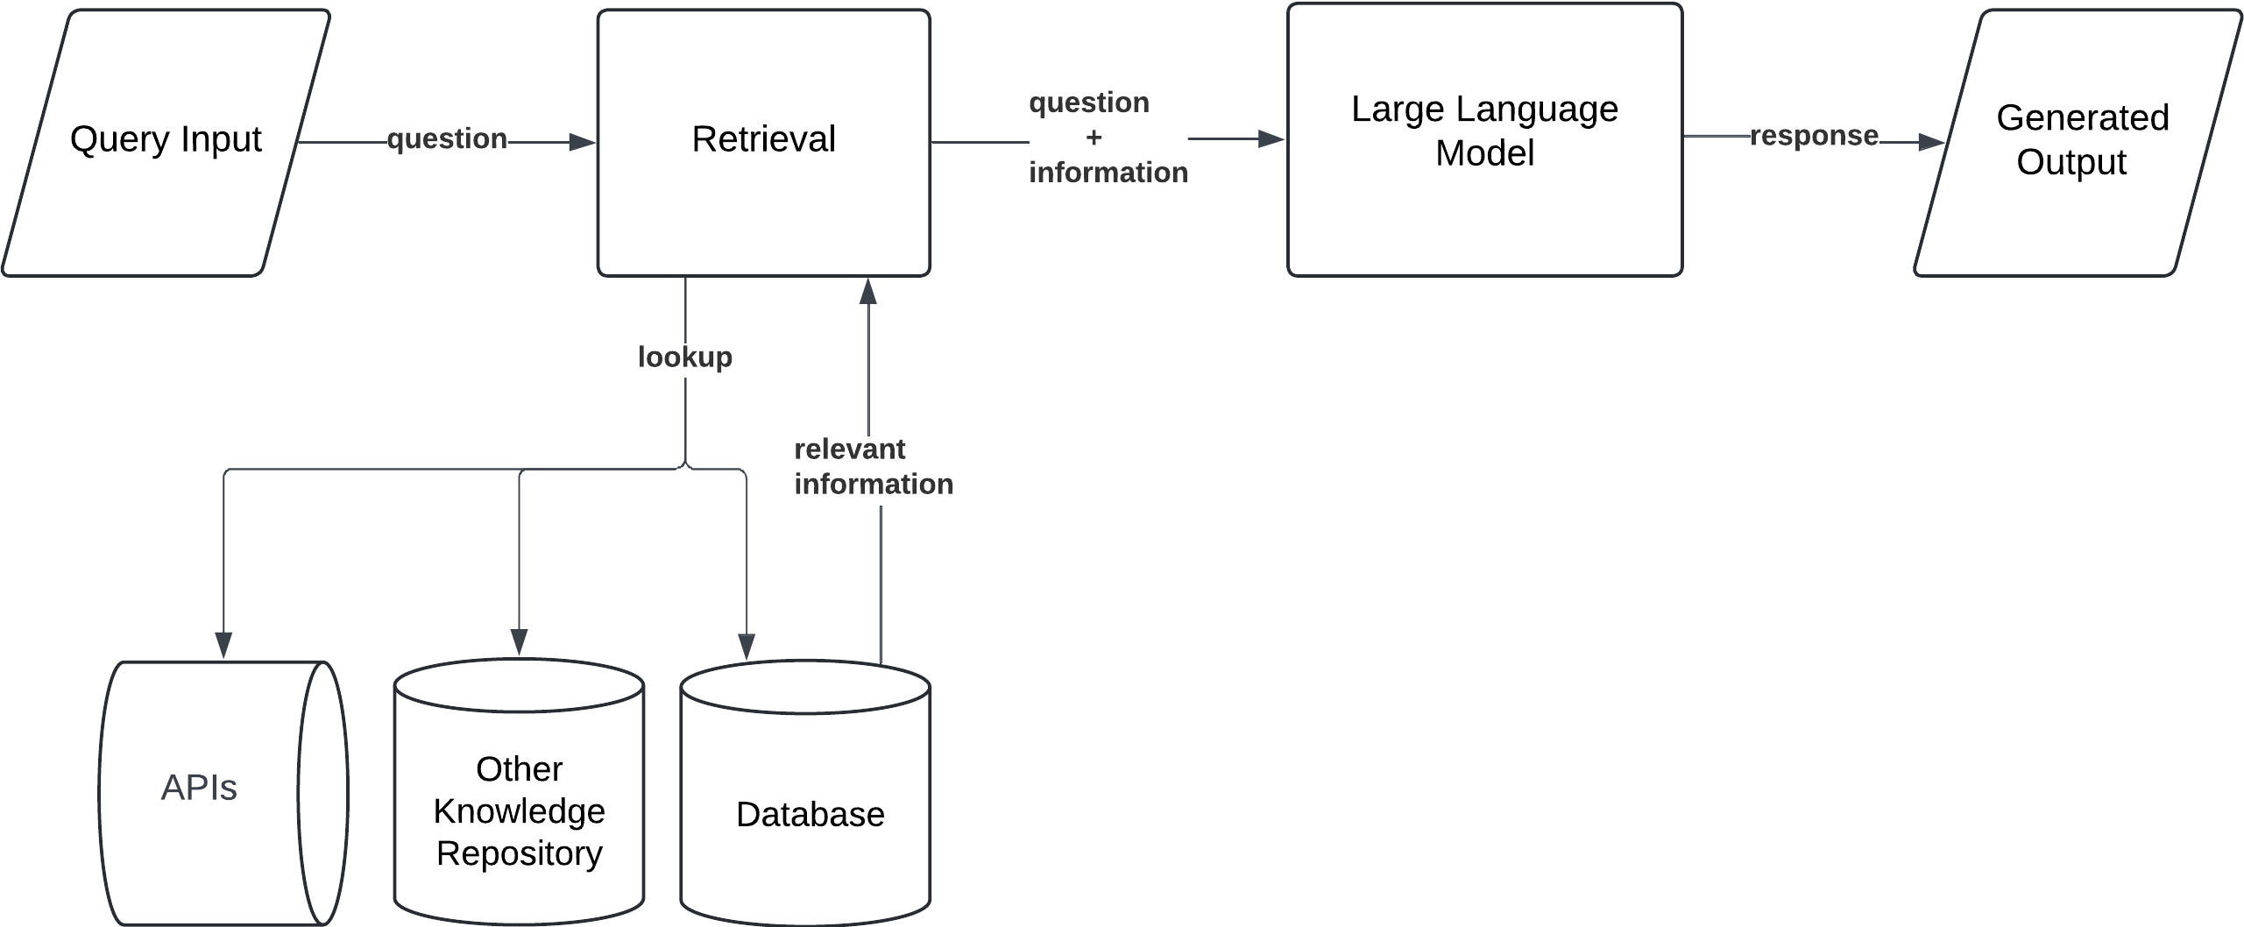
RAG by source (branched)
LLM engine
Use case:
Branched RAG is well-suited for handling complex, domain-specific queries, such as in legal applications or multidisciplinary research. It enables the model to select the most appropriate information source for each query branch, avoiding the noise of merging unrelated data from multiple domains.

Slide 15
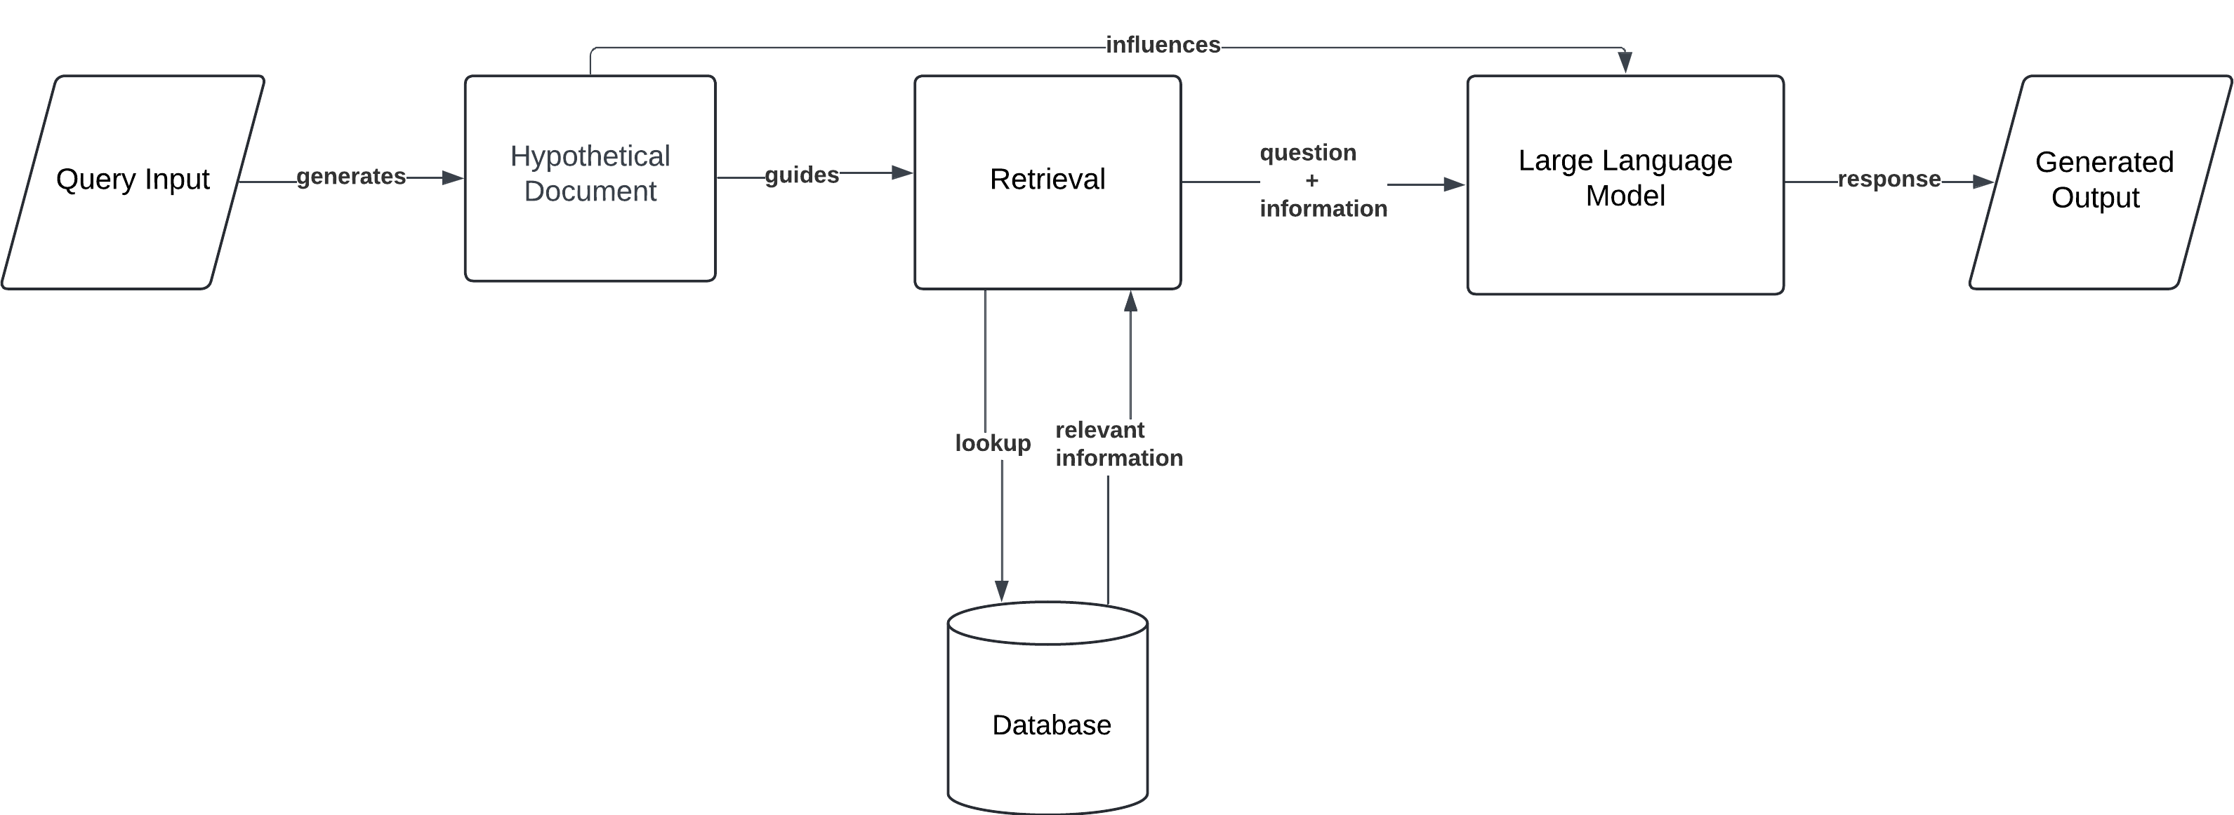
HyDe (Hypothetical document embedding)
1. User enters a query, e.g.,
“How does climate change affect agriculture?”
2. LLM generates a hypothetical answer, e.g.,
“Climate change affects agriculture through changes in temperature, rainfall, and increased extreme weather events…”
3. This generated answer is embedded using the same embedding model used for your document corpus.
4. That embedding is used to retrieve similar chunks from your vector store.
5. Retrieved chunks are passed into the LLM to generate the final answer.
Use case:
HyDE excels in research and development scenarios, where queries are often vague or exploratory. By retrieving information based on hypothetical responses, it helps surface more relevant data to construct complex answers. It’s also valuable in creative content generation, where flexible and imaginative outputs are essential.

Slide 16
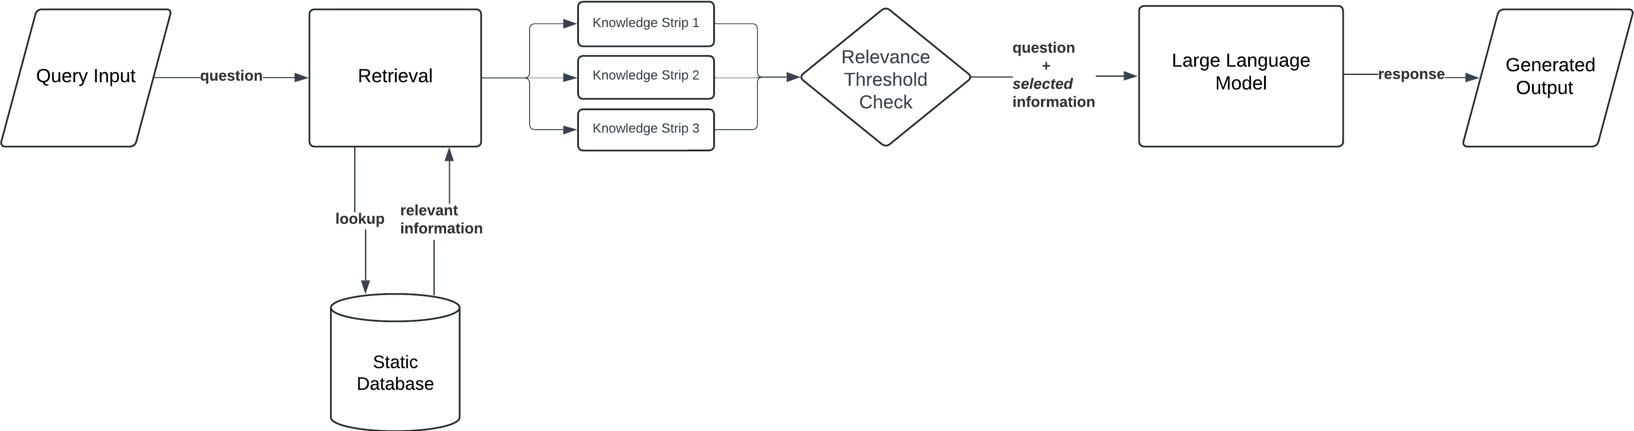
Corrective rag
Strips that fall below the relevance threshold are discarded. If no strip is deemed sufficiently relevant, the system proactively retrieves additional context, often by issuing follow-up searches
Retrieved documents are segmented into smaller “knowledge strips” — concise information units. Each strip is evaluated and scored for relevance to the query.
Use case:
Corrective RAG is best suited for high-stakes domains like legal drafting, medical decision support, and financial analysis, where even small errors can have serious consequences. In such applications, it’s crucial to evaluate both the precision of retrieval and the effectiveness of error correction to maintain reliability and trustworthiness.

Slide 17
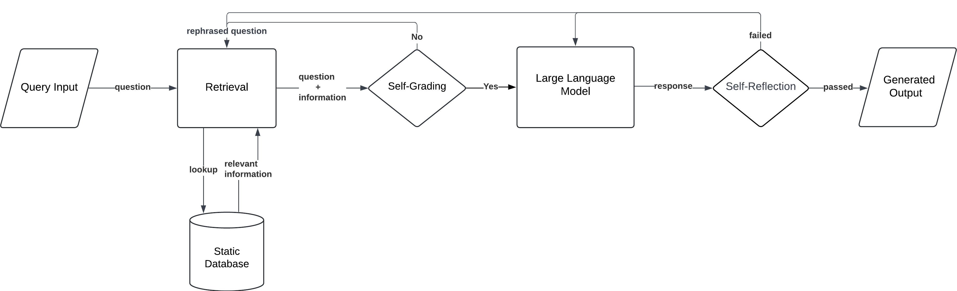
Agentic RAG
Use case:
Agentic RAG is ideal for tasks such as automated research, multi-source data aggregation, and executive decision support. It empowers the model to autonomously gather, navigate, and synthesize information across diverse systems, enabling more informed and strategic outputs.

